Slide 1
Lecture-2
Water Pollution
Centre for Environmental Science and Engineering
IIT Bombay

Slide 2
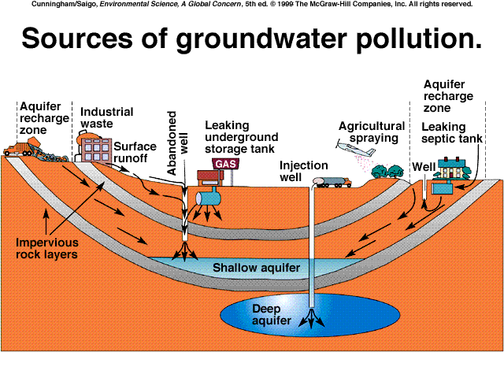
Sources of Water Pollution

Slide 3
Water Pollution
Definition = physical, chemical, biological changes in water quality that adversely affect living organisms. (i.e., degradation)
Types:
Infectious Agents - microorganisms
Oxygen-Demanding Wastes – organic matter
Inorganic Pollutants – mostly metals
Organic Chemicals
Sediment (Particulates)
Thermal Pollution – high temp-low D.O. (dissolved oxygen)

Slide 4
Infectious Agents- Source-warm blooded animals
    Infectious Agents = pathogenic organisms. Water-borne diseases from infectious agents include typhoid, cholera, bacterial and amoebic dysentery, polio, infectious hepatitis, guinea worm and schistosomiasis. Due to lack
    of sanitation.
Analyze coliform bacteria (E. coli). Presume if coliform bacteria are present, infectious pathogens are also present.
MPN test (Most probable Number)

Slide 5
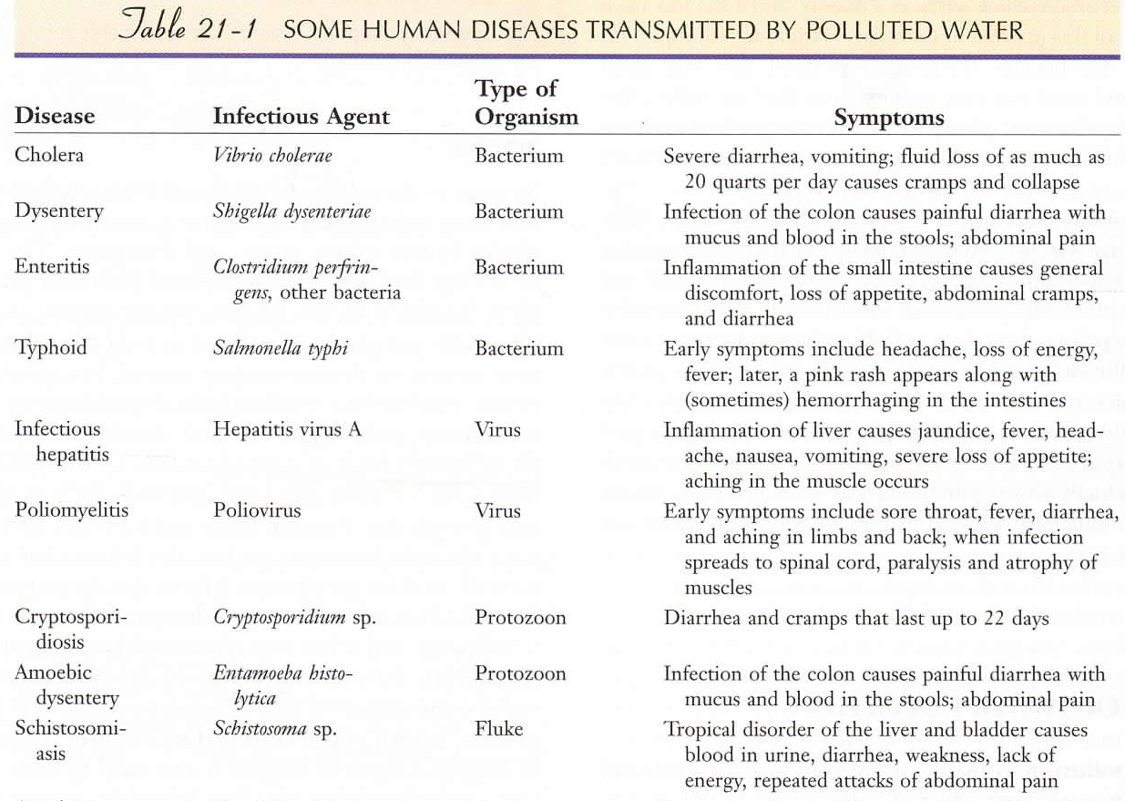

Slide 6
Eutrophication
  Eutrophication is the natural process by which waters (lakes, rivers etc) become excessively enriched with nutrients, typically nitrogen and phosphorus. It is one of the ways in which a water body (lake, rivers, and seas) transforms from a state where nutrients are scarce (oligotrophic), through a slightly richer phase (mesotrophic) to an enriched state (eutrophic).
  Human activities often enhance the rate of change due to activities such as farming, forestry, road-building, industry and waste treatment that cause nutrients to enter watercourses. This nutrient enrichment often results in a population explosion of algae and other aquatic plants.

Slide 7
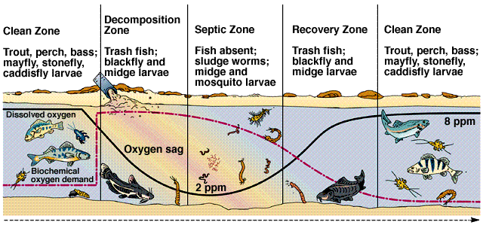
Oxygen-Demanding Wastes
  Oxygen dissolved in water is indicator of water quality. 6 ppm O₂ or more supports desirable aquatic life.
  BOD (biochemical oxygen demand) measures the amount of dissolved oxygen consumed by aquatic microorganisms. Sewage, paper pulp, or food wastes can cause an Oxygen sag, where few fish survive.

Slide 8
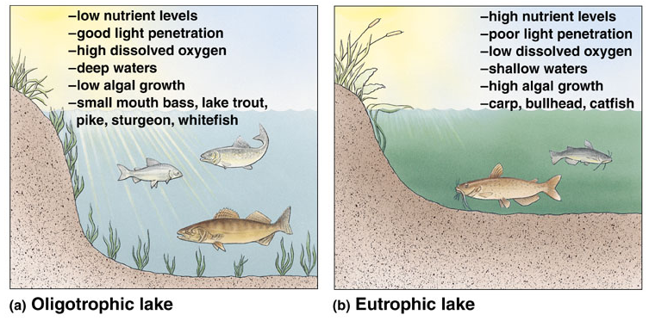
Eutrophication
  BOD and Eutrophication - rapid succession in a body of water because of an increase in biological productivity. (Oligotrophic lakes and rivers have clear water and low biological productivity).

Slide 9
Eutrophication - Solutions
  Wastewater treatment-?
  Limit your fertilizer use and apply at appropriate times
  Control runoff and soil erosion
  Start a compost pile and recycle yard waste
  Conserve water and energy
  Plant trees and other deep root plants

Slide 10
Inorganic Pollutants
  Heavy metals, like mercury, lead, tin, cadmium, selenium, and arsenic are caused by human activities.

Slide 11
Inorganic Pollutants
Toxic Metals: Effect at the DNA level- genetic changes
Mercury poisoning from coal, incineration Causes: - damage to the nervous system
metal retardation
cerebral palsy
development delays
- kidney disorders
Lead poisoning from incineration, pipes, solder (previously in shot, gasoline)
Causes: - miscarriages
- hearing loss
- learning disabilities

Slide 12
Inorganic Pollutants
Nonmetallic Salts:
Arsenic from mining or drainage of desert soils
Causes: - anemia
- cancer
- death.
Sodium Chloride: Salinization
Acids:
Sulfur and nitrogen compounds from coal.
Causes: - pH changes which affect species
- leaches aluminum

Slide 13
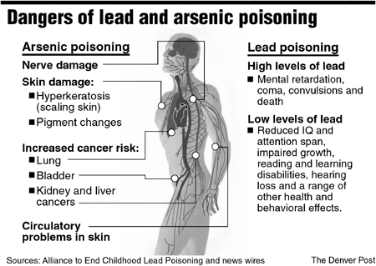

Slide 14
POPs
Persistent Organic Pollutants (POPs) are chemical substances that persist in the environment, bioaccumulate through the food web, and pose a risk of causing adverse effects to human health and the environment.
The "dirty dozen" includes: PCBs, aldrin, chlordane, DDT, dieldrin, endrin, heptachlor, hexachlorbenzene, mirex, polychlorinated dibenzo-p-dioxins, polychlorinated dibenzofurans, and toxaphene.

Slide 15
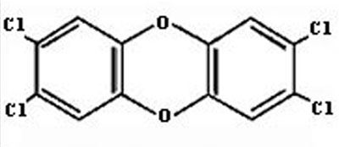
Organic Pollutants
Examples = Dioxin, PCB, DDT (Chlorinated)
Dioxin: stable; slow to degrade

Slide 16
Organic Pollutants - Dioxin
Generated from: Burning wood, coal, oil, household trash, and chlorine bleaching of pulp and paper
Accumulates in fat of animals → biomagnification
Causes: cancer
    weakened immune response

Slide 17
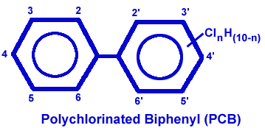
Organic Pollutants - PCBs
PCB = non-flammable; not dissolved in water; high boiling points; does not conduct electricity well. So used for transformers and capacitors.

Slide 18
Organic Pollutants - PCBs
More than one billion pounds of PCBs have been made.
Accumulates in fat of animals → biomagnification
Causes: cancer
hormonal and reproductive disruptions
decrease cognitive abilities (dopamine)

Slide 19
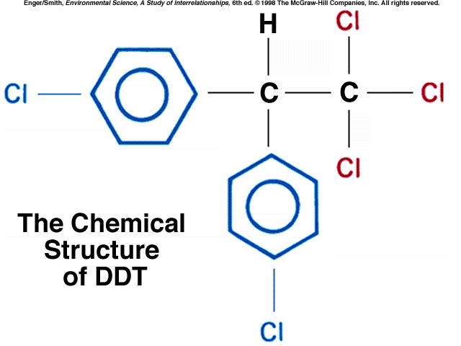
Organic Pollutants - DDT
DDT is an insecticide; stable and slow to degrade.
Paul Muller won the Nobel Prize in 1948 for developing DDT.
Benefits = Controlled spread of malaria; Provided crop protection

Slide 20
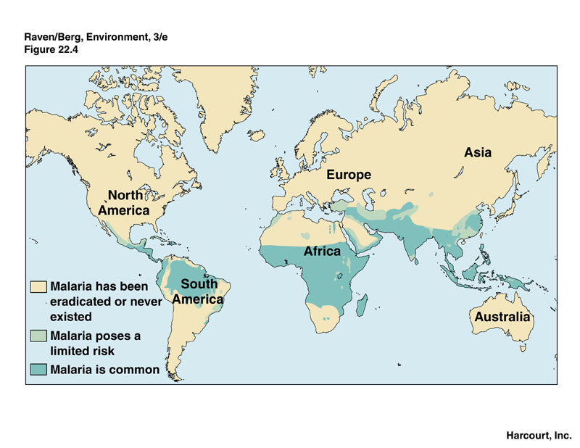
Organic Pollutants - DDT

Slide 21
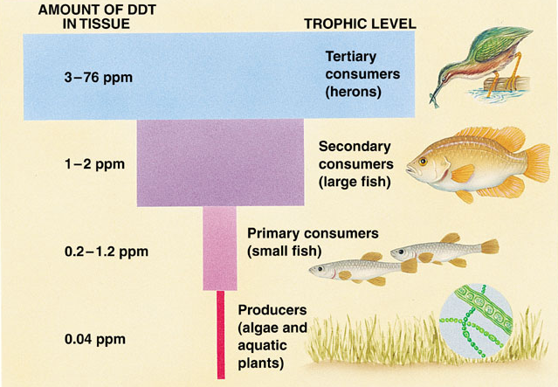
Organic Pollutants - DDT
Problems with DDT: DDT is not metabolized very rapidly by animals; instead, it is deposited and stored in the fatty tissues → biomagnification

Slide 22
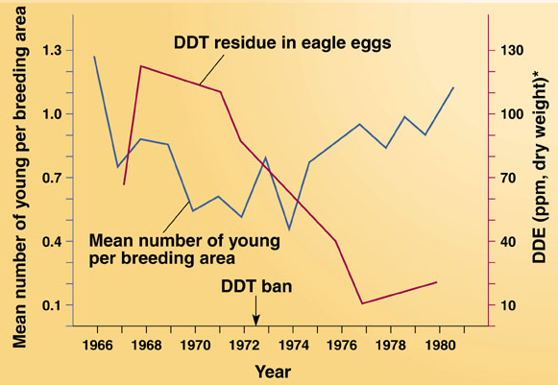
Organic Pollutants - DDT
Toxic to fish
Increased mortality in birds: calcium decreased in egg shells

Slide 23
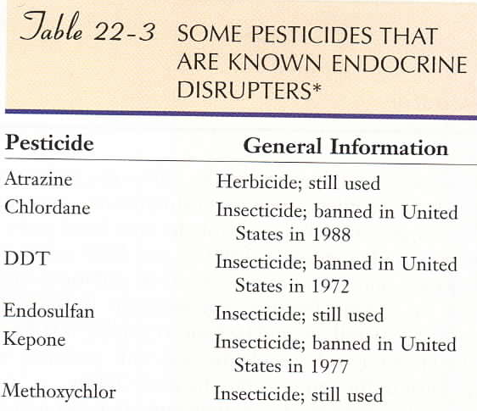
Organic Pollutants - DDT
Estrogen mimic in Vertebrates: feminizes males - lower sperm count; alters behavior
Human Health
decreased mental function
male infertility
cancer

Slide 24
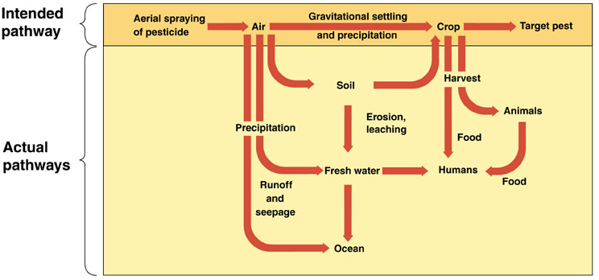
Organic Pollutants - DDT
Unintentional Pathways:

Slide 25
Organic Pollutants - DDT
Problems with DDT (and other pesticides)
Evolution of resistance
Non-target species and creation of new pests

Slide 26
Sediments
    Sediment from erosion and runoff:
    Fills lakes
    Obstructs shipping channels
    Clogs hydroelectric turbines
    Purification more costly

Slide 27
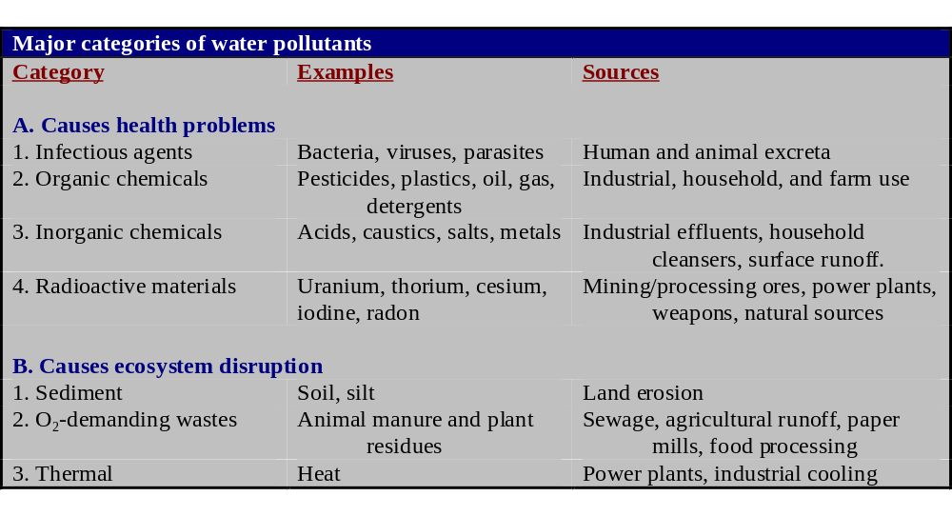
Thermal
    Thermal Pollution = an increase in temperature
    Can cause: thermal shock
    parasites and disease
    greater vulnerability to toxic pollutants

Slide 28
    Specific Sources of Ground Water Pollution
    (rate of breakdown is extremely slow in ground water)
    Industrial waste into aquifer recharge zone
    Surface runoff into abandoned wells - industry, agriculture, home
    Leaking underground storage tanks of gas stations
    Leaking septic tank into recharge area.
    Injection wells for secondary recovery.

Slide 29
Water Pollution Control
Point Source: discharge of pollutants from single point.
Factories, power plants, sewage treatment plants, oil wells.
Non-point Source: sources of water pollution that are scattered or diffuse, not having a specific location. Farm fields, golf courses, lawns, cities, roads, clearcut forests, mines
Reduce the sources of water pollution

Slide 30
Water Pollution Control
Agriculture is the biggest source of water pollution.

Slide 31
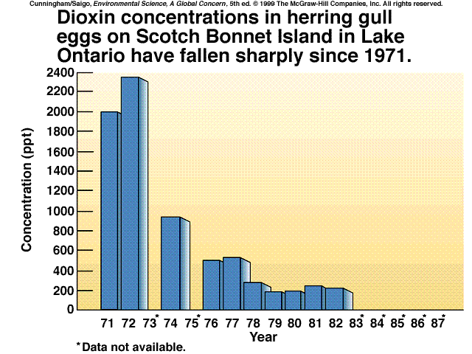
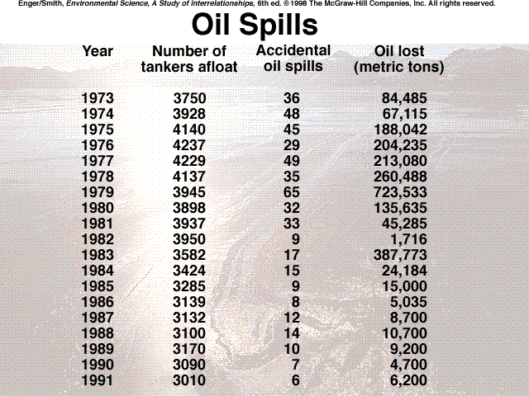
Improved water quality has been one of the biggest success stories of the environmental movement.

Slide 32
Improved Water Quality
    Chesapeake Bay - America’s largest estuary.
    reducing nutrient loading
    banning phosphate detergents
    restoring seagrass and wetlands.
    upgrading wastewater treatment plants

Slide 33
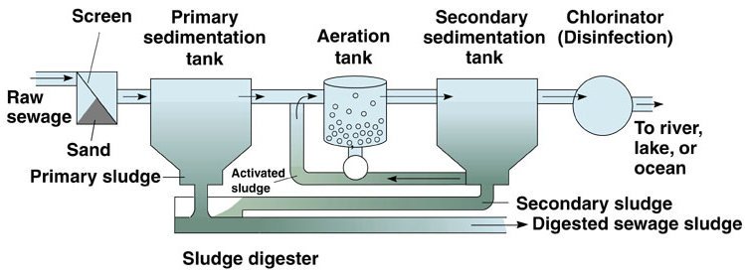
WWT Physical, Chemical, Biological, Advanced WWT
    Primary treatment: physical separation of solids
    Secondary treatment: aeration tank, biodegradation
    Tertiary treatment: remove phosphates/nitrates lagoon/marsh or trickling filter.
    Bioremediation: use of organisms to remove water pollutants

Slide 34
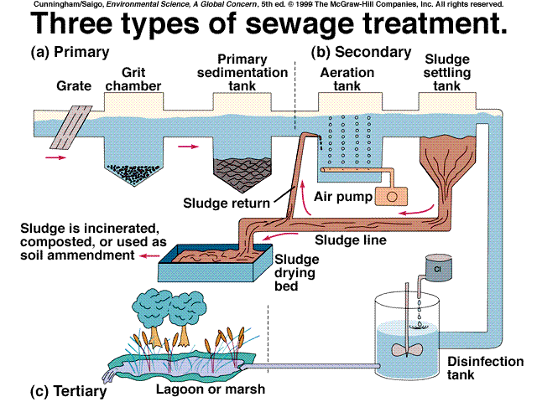

Slide 35
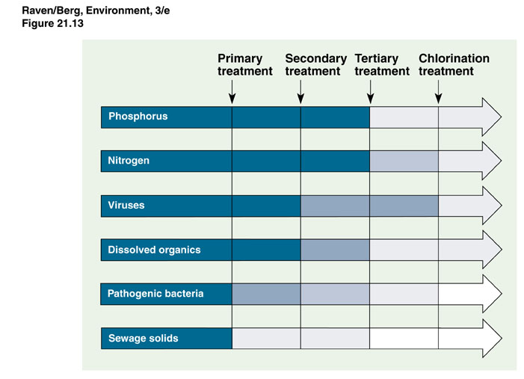

Slide 36
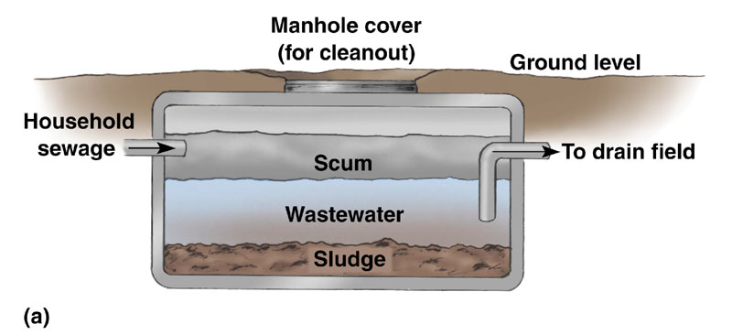
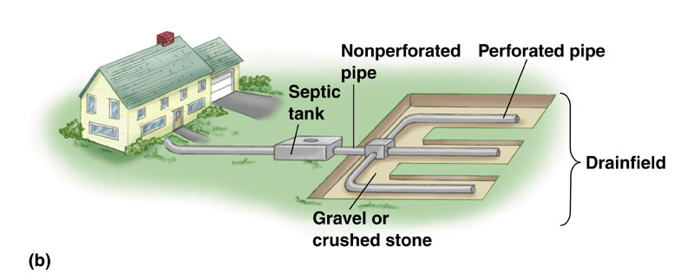
Septic Tanks and Drain Fields.
Domestic Sewage Treatment

Slide 37
Are Conventional Methods of WW treatment suitable for India
Waste Stabilization Ponds
Artificial wet lands
Anaerobic WWT(Waste water treatment)
UASB (Upflow anaerobic sludge blanket)
Eucalyptus plantation

